Slide 1

Programming project in C
2nd Semester / Mr. François
RAFAEL BOBAN / CéDRIC SEBOGO(1st year)
ESIEA | 74 bis Avenue Maurice Thorez, 94200 Ivry-sur-Seine

Slide 2
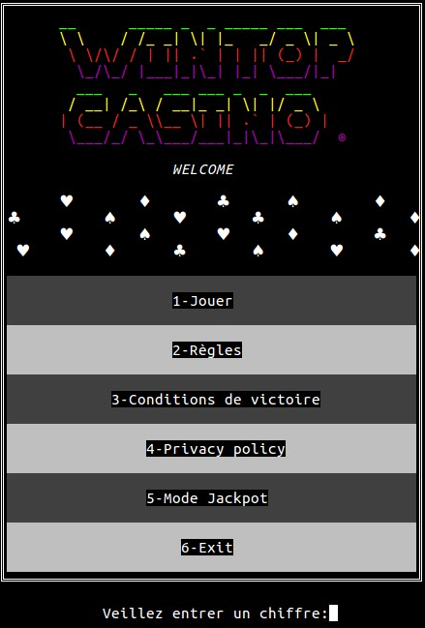
Summary
Introduction
Realization and functions of the program
Bibliography / Webography
Conclusion

Slide 3
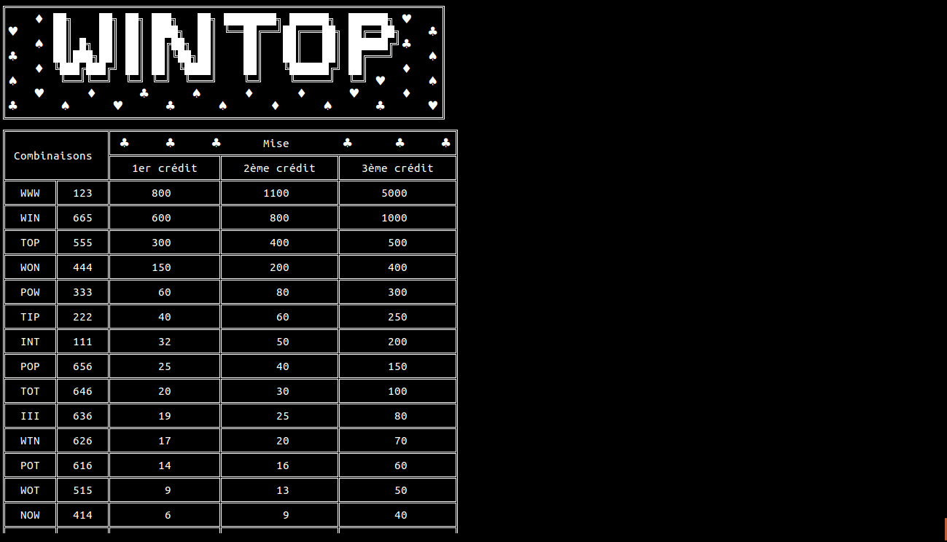
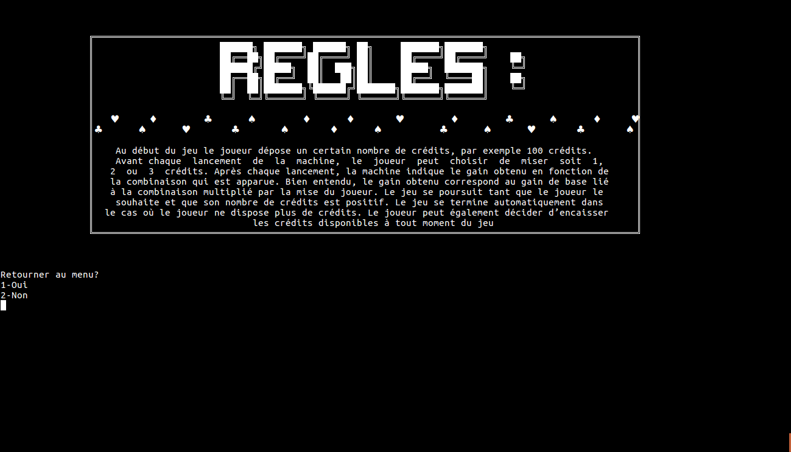
Introduction
Realize a slot machine in C programming within 2 months & a half
Explication of game’s rules

Slide 4
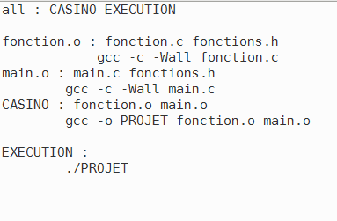

Realization and functions of the program
Game progress
[W] [I] [N] [T] [O] [P] → 6 basics letters we used
« Make » command to launch the game via makefile
Launching message is a simple « Welcome » which
flashes in different colors

Slide 5
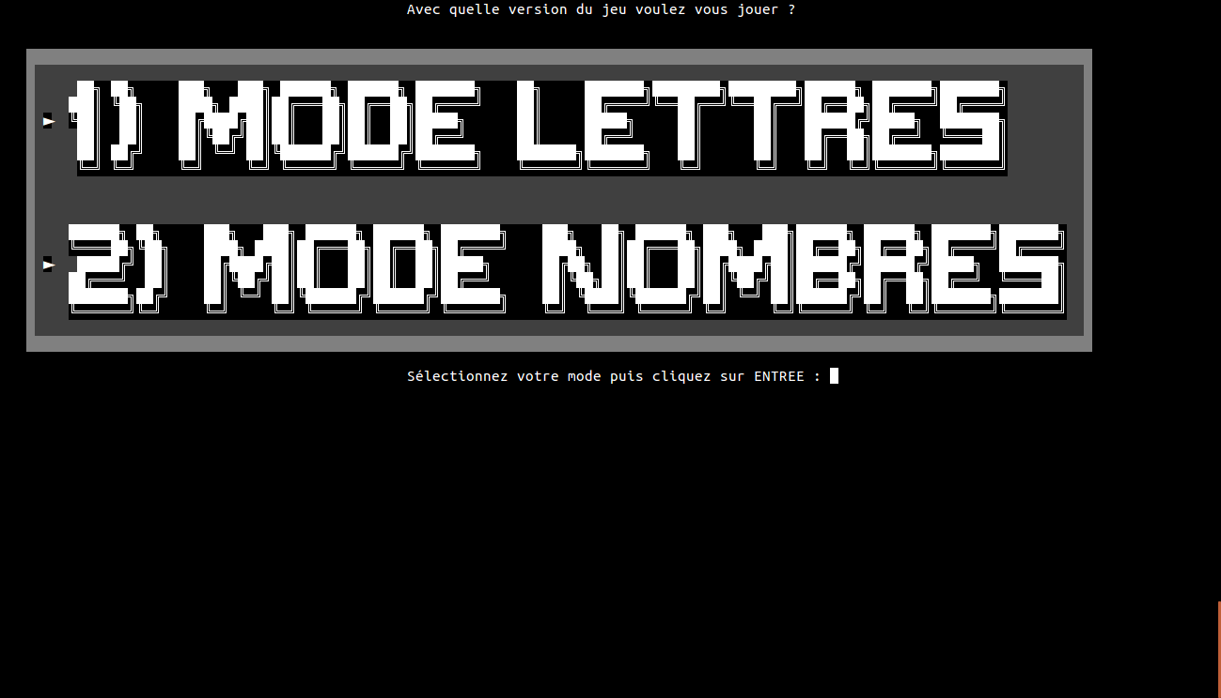
Realization and functions of the program
Game progress
The main part of our game is the menu where we can select 6
different possibilities :
Play → 2 different themes to play with
Letters
Numbers

Slide 6
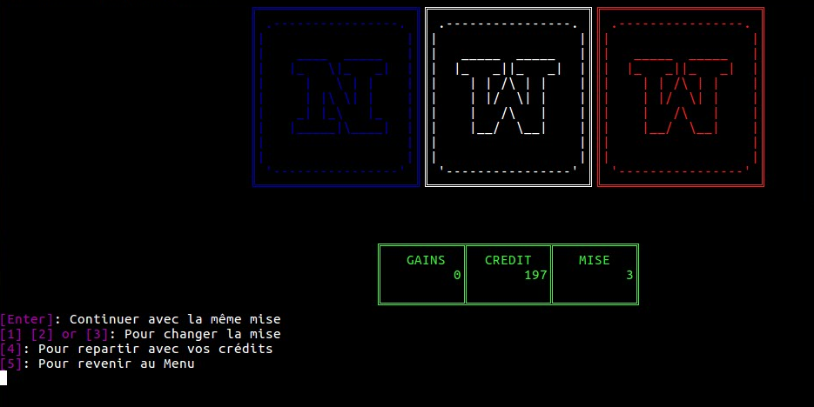
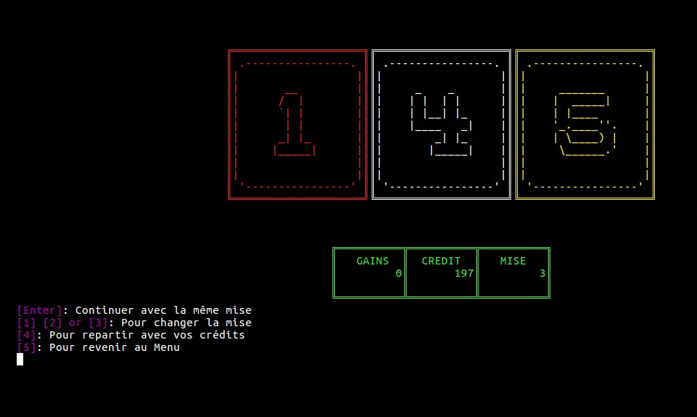
Realization and functions of the program
Game progress
Same principle, but different animations :
Letters Mode
Numbers Mode

Slide 7
Realization and functions of the program
Game progress
“Règles” (Rules) → Informs player on all the game. It’s an
explication in few words on operation of the game

Slide 8
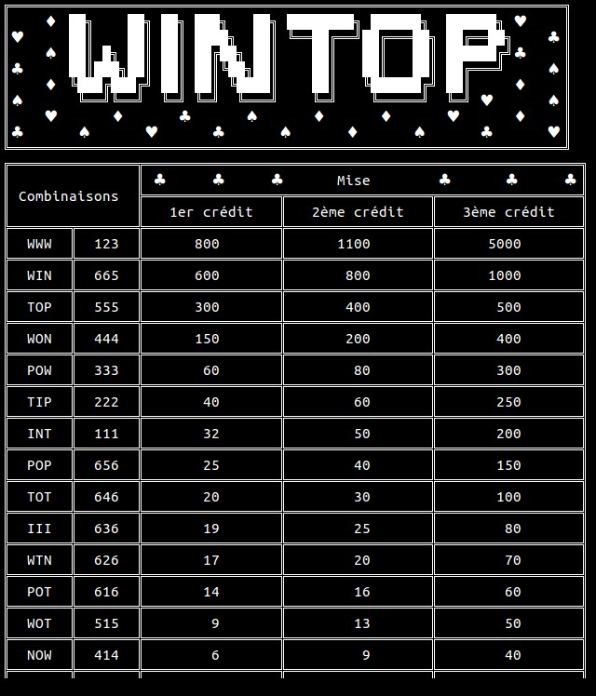
Realization and functions of the program
Game progress
“Conditions de victoire”(Winning conditions) →
In this part, we inserted all various winning combinations

Slide 9
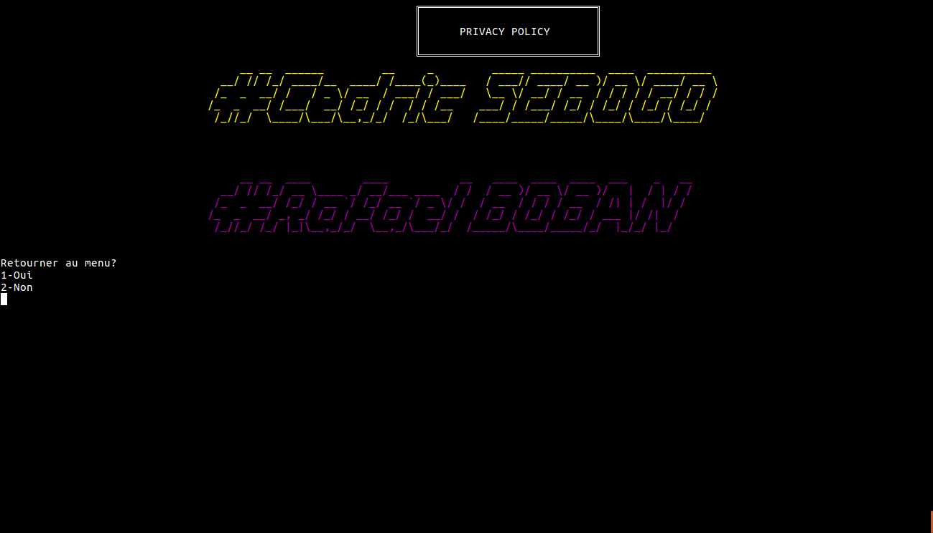
Realization and functions of the program
Game progress
Privacy Policy → #CedricSEBOGO (Creator)
#RafaelBOBAN (Creator)

Slide 10
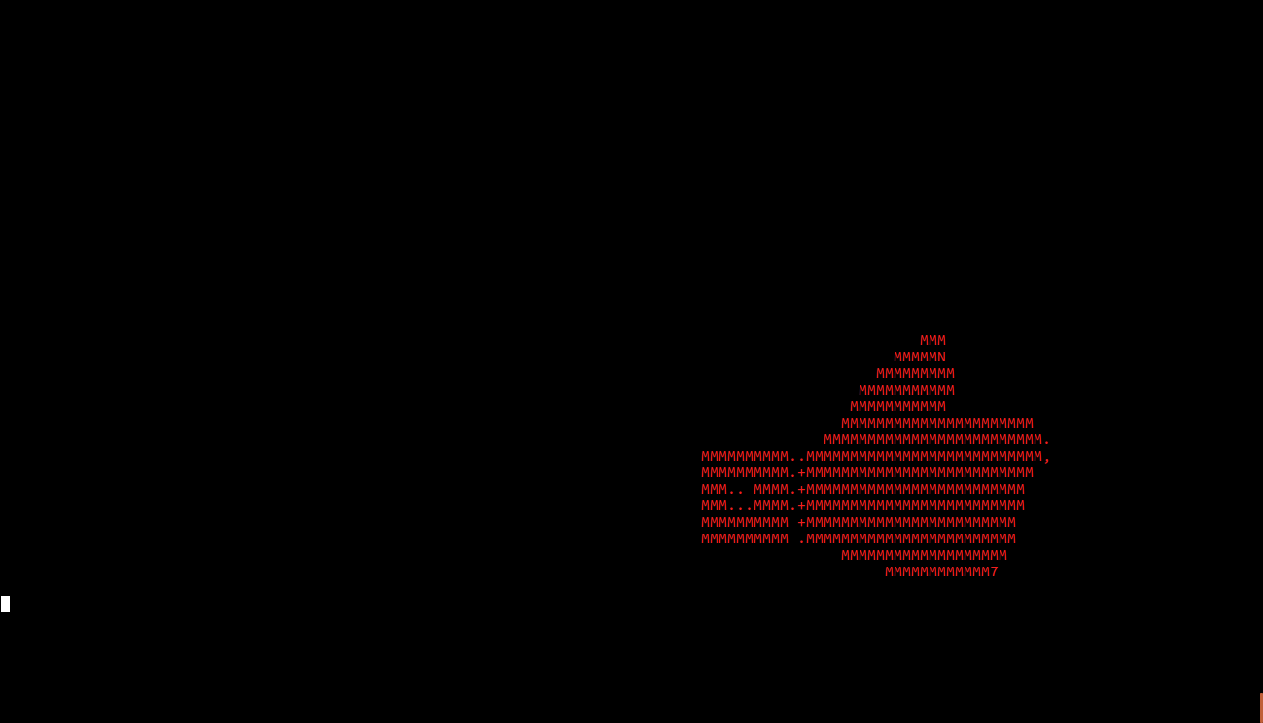
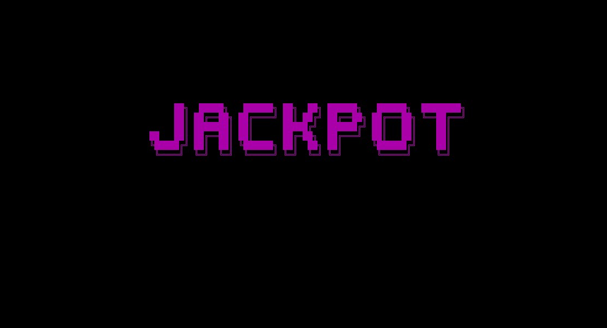
Realization and functions of the program
Game progress
Jackpot Mode → This mode permits to the player to
automatically win the jackpot and see all the different
animations created by game developers

Slide 11
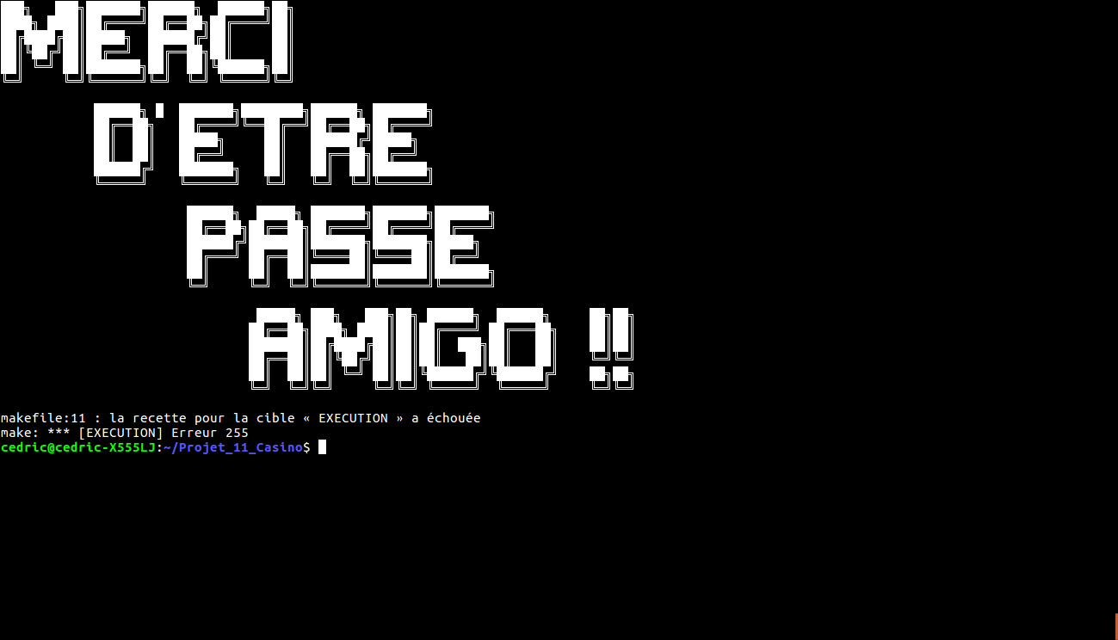
Realization and functions of the program
Game progress
Exit → This option permits to the player to exit the game
and it has a special message delivered to the player

Slide 12
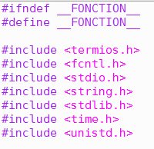
Realization and functions of the program
Libraries
We placed all of our libraries in file fonctions.h to do the
separated compilation with a makefile
We also have added the SOX library (with the “sudo apt-get
sox” command).
Permit us to listen to music in backscreen while playing the
game

Slide 13
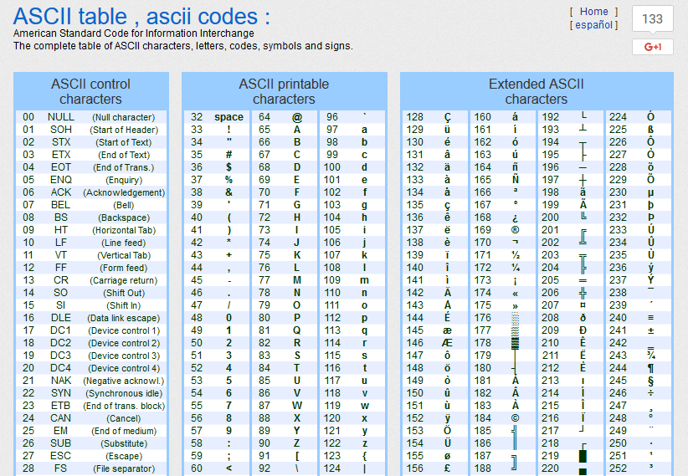
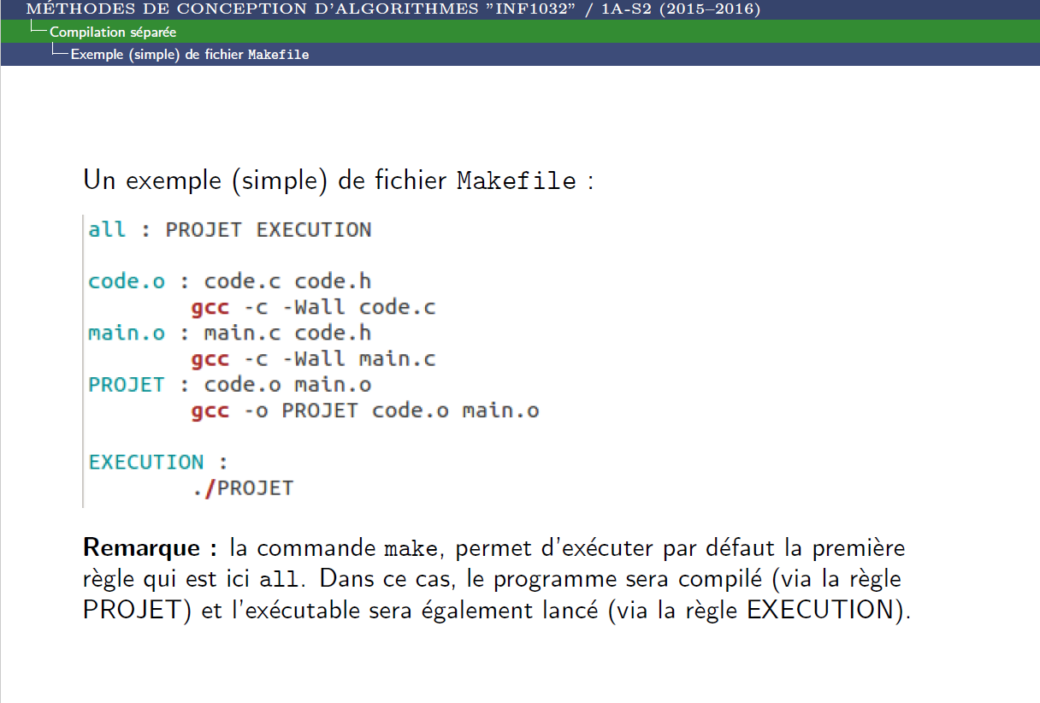
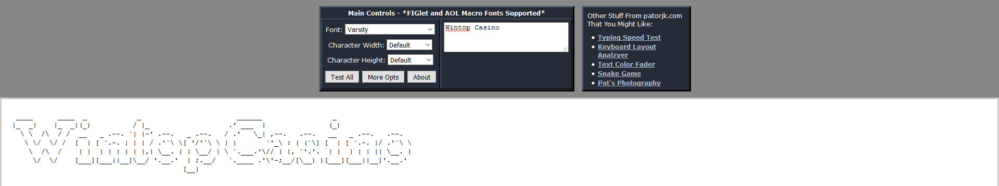

Bibliography & Webography
$1^{st}$ Semester Mr. Beaudoin’s curses
$2^{nd}$ Semester Mr. François’s curses
Openclassrooms programmation in C forum: https://openclassrooms.com/forum/categorie/langage-c
Internet website patorjk (génération de lettres) : http://patorjk.com/software/taag/#p=display&f=Graffiti&t=Type%20Something
Site internet theasciicode (ascii étendue) : http://www.theasciicode.com.ar/
Site internet irongeek (ascii étendue) :http://www.cdrummond.qc.ca/cegep/informat/Professeurs/Alain/files/ascii.htm
Site internet d’une table ascii étendue : http://www.cdrummond.qc.ca/cegep/informat/Professeurs/Alain/files/ascii.htm

Slide 14
Conclusion
Our 3 objectives were reached :
Functional
Easily accessible
Designed
This project helped us to exploit our competences & knowledges in C programming
Working in pair develops :
Team spirit
Colleagues listening

